Slide 1

Mid-Term Presentation SENG 607
Mitra Mirshafiee
Topic:
A Study on Natural Language Processing Application Based on Activity theory

Slide 2

Activity Theory
An umbrella term first coined in 1930s
widely used in both theoretical and applied psychology, and in education, studying crime and criminal activities, professional training, etc.

Slide 3
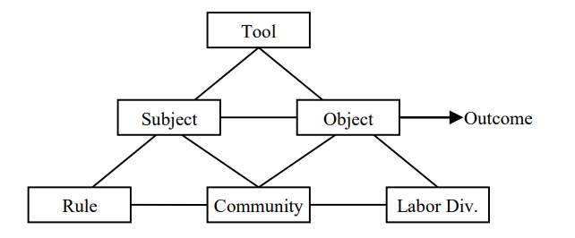
Activity Systems theory
Components of the system:
Object
Subject
Tool
Rule
Division of labor
Community

Slide 4
Research Stages
Question formulation (keywords, scope, etc.)
Locating studies and evaluation (selection of specific topics)
Outcomes and interventions

Slide 5

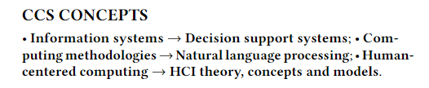
Keywords
activity theory
decision support systems
natural language processing
Human computer interaction
decision support systems
healthcare

Slide 6


Locating studies and evaluation
453,000 papers
Inclusion Criteria:
they had to be published during the past 20 years
they had to be published in journals or conferences.
They must include "natural language processing application" AND "decision making"
Exclusion Criteria:
Study is not given in English
Study is not a duplicate of another
199 papers
They must include "natural language processing application" AND “activity theory“
0 papers

Slide 7


How NLP applications/pipelines can be broken down and analyzed through the lens of Activity Theory?

Slide 8




Tools Computers, Unstructured textual data, Machine learning and Deep learning algorithms, Data Processing Applications
Object Information retrieved, Visualization, Detailed analysis, etc.
Subjects Human agents, Medical Practitioners, Financial Analysts, etc.
Outcome Increased performance respective to the problem and field

Slide 9
Activity | Remind\Alert | Monitor | Predict | Assign Codes
Objectives | Alert adverse events immunization | drug-drug interaction syndromic presentation monitoring patient progress | suicide intent adjustment to cancer cognitive/physical impairment | assign a pre-defined code to reports for billing purposes
Tools | doctor reports, one-to-one conversation with the patient | Libraries such as Medline and applications developed based on them, clinical patient records | doctor reports, one-to-one conversation with the patient | Manually assigned and encoded datasets, billing reports
Subjects | Clinicians, Administrators, | Patients, Researchers, Clinicians | Researchers, Clinicians | human coders, Researchers, Administrators
Sample papers | 1. Automated identification of adverse events related to central venous catheters 2. Using Electronic Medical Records to Enhance Detection and Reporting of Vaccine Adverse Events | 1. Toward a complete dataset of drug–drug interaction information from publicly available sources 2. TIEVis: a Visual Analytics Dashboard for Temporal Information Extracted from Clinical Reports | 1. Prediction of breast cancer distant recurrence using natural language processing and knowledge-guided convolutional neural network 2. Suicide Note Classification Using Natural Language Processing: A Content Analysis | 1. Automatic construction of rule-based ICD-9-CM coding systems 2. “Can NLP techniques be utilized as a reliable tool for medical science?” - Building an NLP Framework to Classify Medical Reports
A deeper dive into nlp in healthcare (inspired by *)

Slide 10
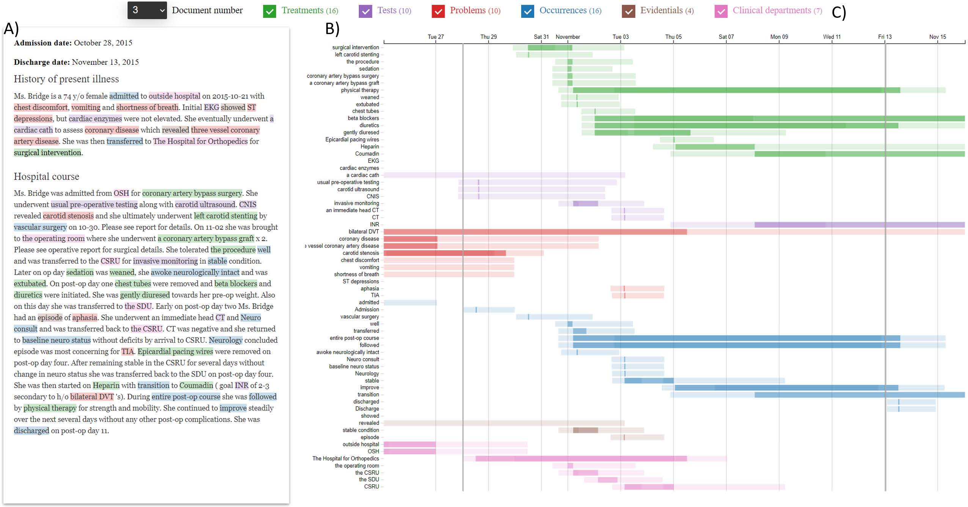
TIEVis: a Visual Analytics Dashboard for Temporal Information Extracted from Clinical Reports *
Activity:
Assign codes
Subjects:
Healthcare professionals
Objective:
Facilitate decision making in identifying the disease, related departments, and potential prescription.
Tool:
Natural language processing packages that identify specific spans of text each with some degree of certainty.

Slide 11
What studies present evidence quantifying the impact of NLP results and benefit in decision making?

Slide 12


Addressing an issue first: There is a significant gap in the evaluation of NLP systems in healthcare.
We will categorize the objective of this question into the following bullet points:
incorporate archival and unstructured notes
1
create models for tracking and interpreting community development
2
improve reasoning
3
provide reliable and reproducible advice
4
prioritize evidence and test results
5
Engage professionals and the community to promote effective communication and coordination of the activity.
6

Slide 13
What type of evaluation techniques were mostly incorporated and to what level did human intervention play a role?

Slide 14

Nearly all these datasets were initially built, encoded, or categorized by humans.
In the field of healthcare, clinical results can either be validated internally (using data from the original study sample) or externally (measured on a different sample).
NLP in healthcare:
intrinsic (evaluating an NLP system in terms of directly measuring its performance on achieving its immediate objective)
extrinsic (evaluating an NLP system in terms of its performance in accomplishing an overall goal in the system where the NLP algorithms are a part of a broader program or pipeline)

Slide 15
Future pathway
Short-term:
Refining the research questions (especially the last two questions)
Review more papers that validate NLP based on extrinsic evaluation techniques and look at it in a large setting.
Long Term:
Pick a specific medical activity to study
collect a dataset (tool) from an organization consisting of healthcare professionals and patients (subjects in various communities), analyze the rules mediating the relationship between communities and tools, and define the goal (objective that leads to output) that we want to accomplish with NLP.

Slide 16
Thanks for your attention!

